Slide 1
Preparing the Pupils/Students for Global Stages (AFED as a case-study)
Orji Kanu Emmanuel
National President, Association for Formidable Educational Development (AFED) Nigeria
@ Professional Educators Conference 2021

Slide 2
Do you Remember Her?
Faith Odunsi Won Global Mathematics Tournament Competition

Slide 3
Introduction
What are the most important skills that students need to prepare for the 21st Century workforce? More importantly, how can educators help kids gain these competencies?
“Your local corner is a stage and part of the global stage for that matter. Do the right thing, one at a time and be consistent, you may never believe the influence you can contribute to the global economy from that point”

Slide 4
Let’s start with a statistics
According to UNICEF, “one in every five of the world’s out-of-school children is in Nigeria. Even though primary education is free and compulsory, about 10.5 million of the country’s children aged 5-14 years are not in school”. This is not true as these statistics cover only the schools recognized by the government.
Research conducted by Professor James Tooley of the University of Buckingham, international Patron of AFED and champion of low-cost private education worldwide, shows that about 26% of the total population aged 5-14 are in government schools, 70% in private schools and a very significant but small 4% are out of school.
Another research conducted by DEEPEN (Developing Effective Private Education in Nigeria by UKaid) in 2018, shows that over one million children of primary and pre-primary age are enrolled in approximately 18,000 private schools – totaling 70% of enrolment at the primary level. Looking at this in contrast with the 1001 primary schools that the State Universal Basic Education Board (SUBEB) of Lagos state are in charge of, and you can draw a simple conclusion that the Private schools in Lagos-Nigeria accommodate most of the children that are considered to be out of school because a lot of them are not recognized by the government, and this is a situation that AFED as an association is striving to correct.

Slide 5
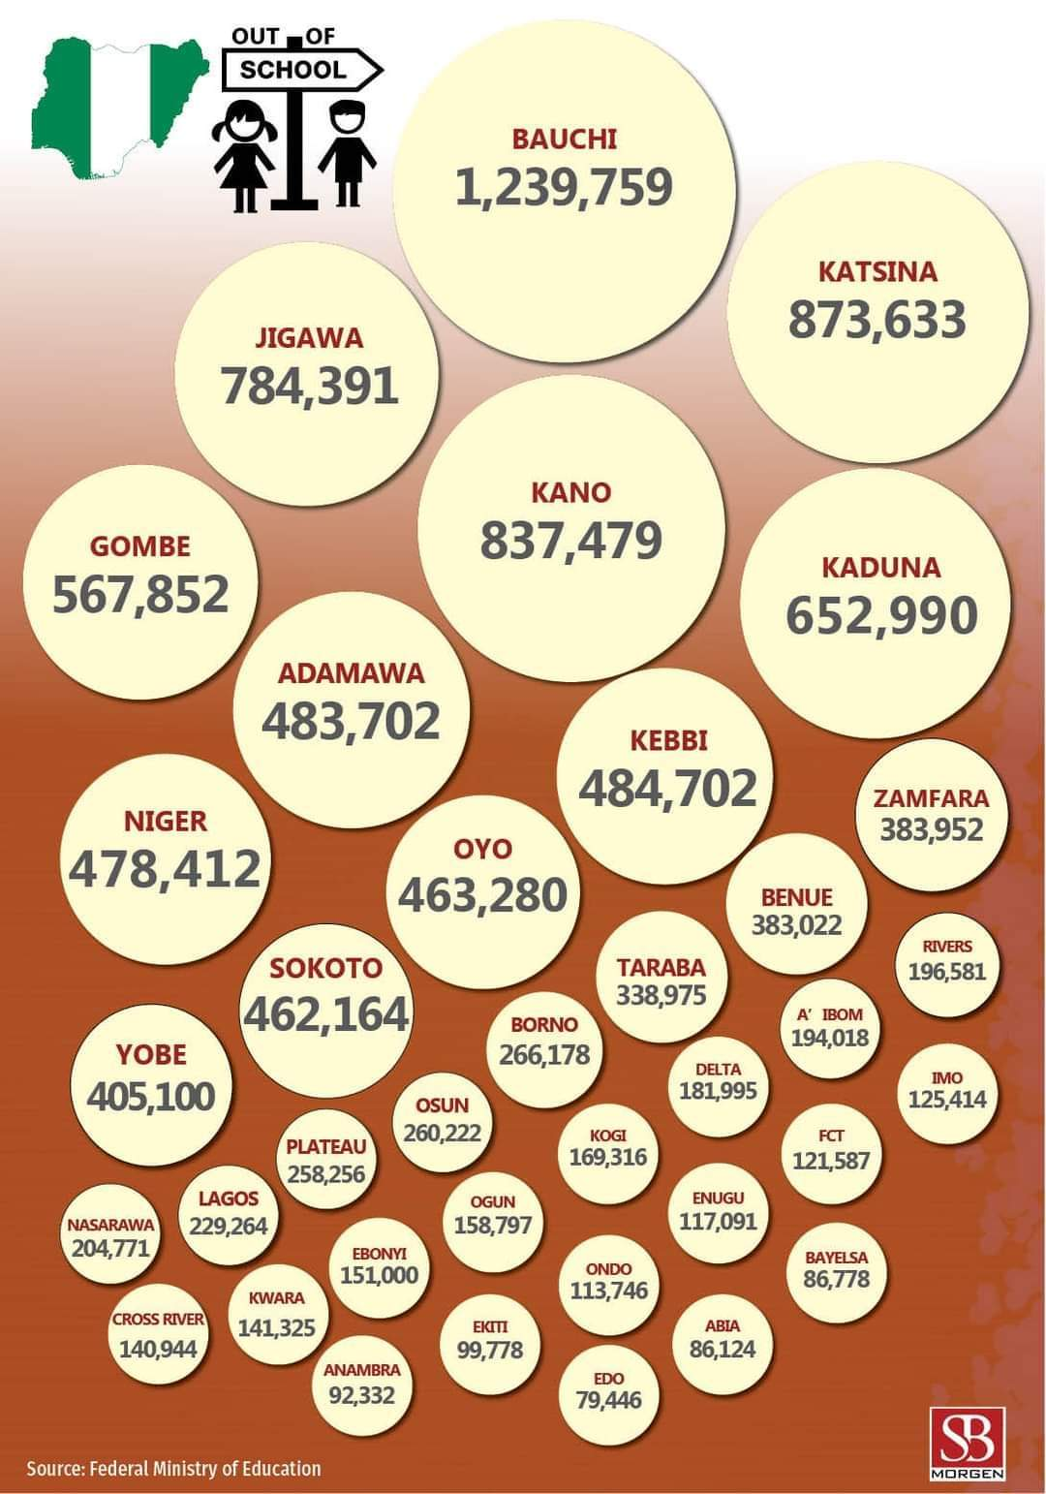
Statistics of Out Of school Children

Slide 6
Meanwhile Of the number of children already in school, how do we prepare them for the global stage.? Can they compete with their counterparts in other parts of the world? This presentation shows very important things we can do to raise children who can compete in the world stage.

Slide 7
1. Encourage Teamwork
One of the biggest things that students today need to succeed at work is the ability to work as a team. They need to understand how to communicate, compromise and share credit so that they can be a valuable contributing member to projects. This can be taught in school by encouraging teamwork on some projects and assignments.

Slide 8
2. Be Future-Focused
In many ways, real life begins at graduation for students -- they begin to put their knowledge into use and manage their own finances and life plans. So schools should focus not just on whether students have learned material, but where it will take students later. Will they be a financial, career and personal success because of what they learned? And when students ask, “Will I ever even use this in real life?” have an answer -- and an example of why they will.

Slide 9
3. Teach Complex Thinking Skills
In the workplace, it’s not just about getting to the right end, but getting there by the best path. This is something that can be reinforced in high school by giving students context for decision-making and solving problems.
“[Jobs in the modern workplace] require innovation, creativity, and the ability to look at a task and not only see the outcome, but also imagine different ways to achieve it. This is why I really like international affairs, politics and even complex math,” said Marder, who is a recent graduate.

Slide 10
4. Round Out the Curriculum
There is no one magic solution that will prepare students today for tomorrow’s workforce, but giving them a well-rounded education including arts; Science, Technology, Engineering and Math (STEM); history and communications courses can help.
“STEM is integral to solving practical problems, but STEM alone is not enough. Music and the arts encourage creativity and innovation while underlining self-discipline and providing individual insights into science and math. History informs us of the struggles and successes of past innovators. Communication helps us ask questions, customize our learning, and spark our passions,” said Collias.

Slide 11
5. E-Learning is the Present and the Future

Slide 12
AFED is at the centre of Raising global leaders
AFED (Association for Formidable Educational Development) as a case-study
Association for Formidable Educational Development (AFED), an umbrella for low-cost schools providing quality education for all, is a registered association in Nigeria with its national secretariat situated at 215/217, Ikorodu Road, Ilupeju, Lagos, Nigeria.
The association has played great developmental roles in the educational system in Lagos State and some other states in Nigeria. AFED's membership comprises of both the approved and yet to be approved schools in Lagos State.

Slide 13
Aims and objectives of AFED (Roles of Private School Association)
To ensure that every school aged child gets access to quality and affordable education
To promote unity, co-operation and friendly atmosphere among member schools
To guide, motivate, encourage, assist and give technical advice for the development of member schools to meet set standard
To solicit for funds and educational aids, and accept same from individuals, government, local and international bodies, groups and organizations for the benefits and improvement of member schools

Slide 14
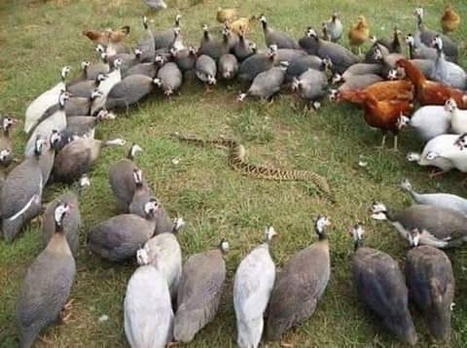
In Conclusion
So what and how shall we go?
United Fronts – every hand on deck in the education Industry, policy makers with implementable policies. i.e. every stakeholder in the education industry must create make provisions and create platforms as to this regards
This picture shows the power of unity. How difference can be ignored to fight a common enemy.

Slide 15
2 Curriculum Overhaul and Alignment: the 18th century of body of knowledge vs 21st century needs 21st century teacher vs digital skills, leading learning, facilitating influence Aligning for opportunities (Buckingham) The pupil’s vs content; what our contents should do – motivate, influence, augment, facilitate, intensify etc.

Slide 16
Thank you

