Slide 1
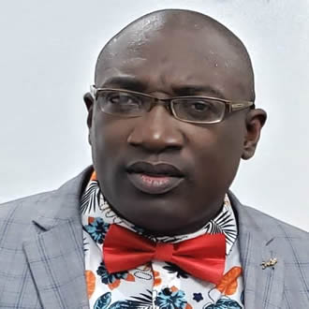
The Visionary
School Administrator
Presented By
Alh. Dr. Wasiu Adumadeyin FIMC
Alh. Dr. Wasiu
Adumadeyin
At the South-West Professional Educators Conference, 26th August 2021

Slide 2
What it means to be visionary
Staff login

Slide 3
What an Administration is
Administration means a cooperative effort of a group of people in pursuit of a common objective.
It is the use of men and material resources to accomplish a purpose E.N Gladden
Administration is the direction, coordination and control of many persons to achieve some purpose L.D White

Slide 4
School Administration is then the management of all school operations to achieve school goals. The goal could be inform of the vision statement of the school.

Slide 5
Examples of School Vision
1. Statement To build a community where all children feel loved, respected and encouraged to develop to their fullest potential
2.Our vision is for each child to develop a curiosity of learning, discover their interest and grow in their love of learning.
3. To equip our young people with the skills and mindset to thrive and then take on the world.

Slide 6
What makes a visionary administrator
1.He must be knowledgeable about teaching, learning process and school policies
2. He/she should have a strong communication and inter personal skills.
3. Good ability to delegate responsibilities .

Slide 7
4. Must be committed to school vision.
5. Must have growth mindset.
6. Must be emotionally balanced
7. Should be fair and firm in judgment.
8. Must possess effective teaching ability.
9. Must have basic knowledge of I T

Slide 8
Click on save when ur’e through

Slide 9
21st Century Strategies Smart School Administrators Can adopt For School Growth
Make your school beautiful, unique and attractive.
2. Create a selling point for your school.
3. Employ the right staff, train and retrain them.
4. Don’t condone inefficiency and laziness and reward hard work .

Slide 10
5. Have a good relationship with the operating environment.
6. Have a good relationship with regulatory authorities
7. Have a policy on:
a Staff and staff welfare,
b. Relationship with parents School contractors & vendors
c. Community
d Admission and student activities.
e. Advertisement policy

Slide 11
8. Adopt e-learning techniques
9. Pray (with prayer anything is possible)
Conclusion
" Acquisition of knowledge is good, utilisation is the Ultimate"

Slide 12
Alh. Dr. Wasiu Adumadeyin

